Slide 1
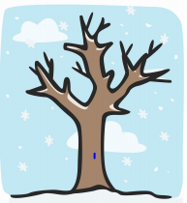
Changes – Day 1 and 2

Slide 2
Changes – Create your own timeline…
Soon you will be going in to a new year group in school and for some of you, moving to a new school.
Today you will create a timeline for your time at Greenbank or any other schools you may have been to.
Timelines are used to show events through History in chronological order.

Slide 3
Changes – Create your own timeline…
Fold 4 pieces of A4 paper in half

Slide 4
Changes – Create your own timeline…
Each half of the paper will be dedicated to one year in Greenbank (example below). IN each section include:
Stories/memories from the year.
Pictures/illustrations.
What you enjoyed.
What you found hard/overcome
Who were your friends.
Memories from outside of school from that year.
Likes and dislikes. Have these changed as you’ve gotten older?
Reception
Year 1
Year 2
Year 3
Year 4
Year 5
Year 6

Slide 5
Changes – Create your own timeline…
Your Year 6 Sheet…
If you are in year 6, write and draw about all the amazing things you have loved about Primary school. You could even create a year 7 one, about your hopes and wishes for next year.
If you are in year 5, write about your hopes and wishes for your next school year. What are you looking forward to.
Reception
Year 1
Year 2
Year 3
Year 4
Year 5
Year 6

Slide 6
Changes – Create your own timeline…
Attach your timeline to create one big journey you have taken through school. Look at all of the amazing things you have achieved!
Reception
Year 1
Year 2
Year 3
Year 4
Year 5
Year 6

Slide 7
Changes – Create your own timeline…
When you have finished, why not pick someone from history, a period of history or someone you are inspired by and make a timeline of the period or their lives.

Slide 8
Changes – Day 3

Slide 9
Changes – Moving forward to your new year.
Soon you will be going in to a new year group in school and for some of you, moving to a new school.
Year 5
Today you will fill in a booklet all about yourselves ready for your new school teacher, this can be given, emailed or passed to your new teacher.
Year 6
If you are year 6, create a guide to for the year 5’s to help them in their final year at Greenbank.

Slide 10
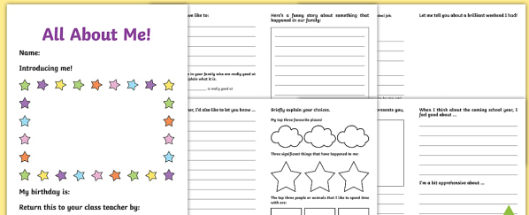
Changes – Moving forward to your new year.
Year 5
Fill in your transition booklet (this can be found on the home learning page), If you do not like the format or don’t have access to a printer, why not make your own!

Slide 11
Changes – Moving forward to your new year.
Year 6
Your guide for the year 5’s…
Write about things you found difficult in year 6 and some advice on how to overcome these.
Write about things you loved in year 6.
Write about things you didn’t chance to do that you wished you could have. What would you tell the year 5’s?

Slide 12
Changes – Day 4

Slide 13
Changes – The world around you
The world changes all the time. In just 30 years we have seen changes in technology, the way we learn, how we communicate etc.
How do you think the world will look in the future?
How do you hope it will look?
Today’s activity you will create a piece of artwork to represent how you think the world around you might change.

Slide 14
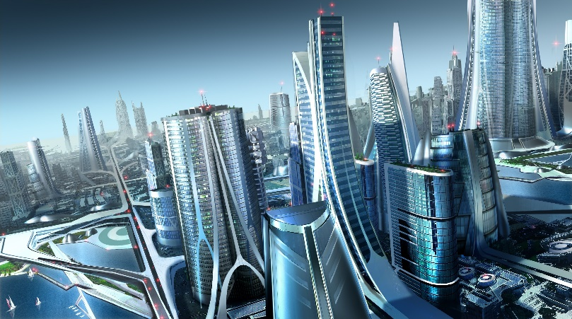
Changes – The world around you
Your artwork…
It can be about you. You could include things you think you will have/be doing when you are older.
It can be the near or the distant future.
It can be about the world in general, what will our technology be like? What will the landscape look like?
What do you hope the environment will look like
You can be as creative and imaginative as you like!
You can draw, create on Ipads, make sculpture, use collage.

Slide 15
Changes – The world around you
To help…
Look at images of cities from the past and now, They might inspire you by seeing how much has changed.
Look at how food, schools, toys, technology, civil rights might have changed.
Images of Liverpool through history…
https://www.liverpoolmuseums.org.uk/collections/social-history/growing-up-in-photographs

Slide 16
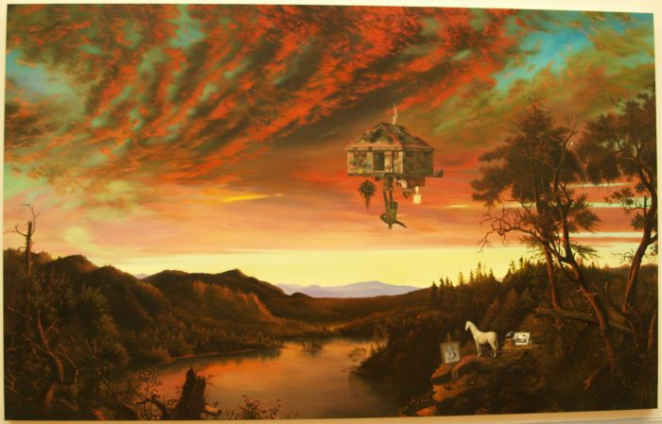
Changes – The world around you
Ged Quinn’s futurist landscape. Could this inspire you?

Slide 17
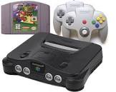
Changes – The world around you
Add on task…
So much has changed since the beginning of time, but in the last 150 years we have seen the biggest technological developments. Why not research how something you use daily might have changed over years. Create a fact sheet or poster about your research.
Examples of what to research…
Phones
TV
Internet/computers
Travel – cars, aeroplanes, boats.
Games consoles

Slide 18
Changes – Day 5

Slide 19
Changes – Worry Dolls
With all of the changes in the world at the moment and with school, we can all get a little worried.
Today you will make Guatemalan Worry Dolls.
Being creative and talking about worries is always helpful, today we will do both!

Slide 20
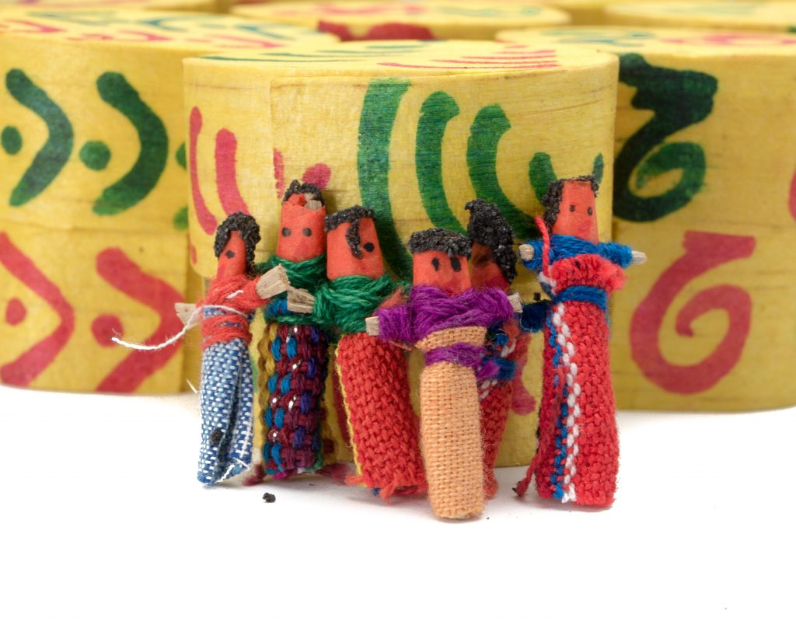
Changes – Worry Dolls
Worry dolls are handmade dolls, most often made in Guatemala from wire, wool and small pieces of fabric. The dolls are often tiny, though Western versions can be much larger. Traditionally, the dolls are given to children to help them with their worries. Children will share their concerns with the dolls and then place them under their pillows where the worries will go away over night.

Slide 21
Changes – Worry Dolls
To begin…
Do you have any worries?
Have a think about them.
What would help this worry go away?

Slide 22
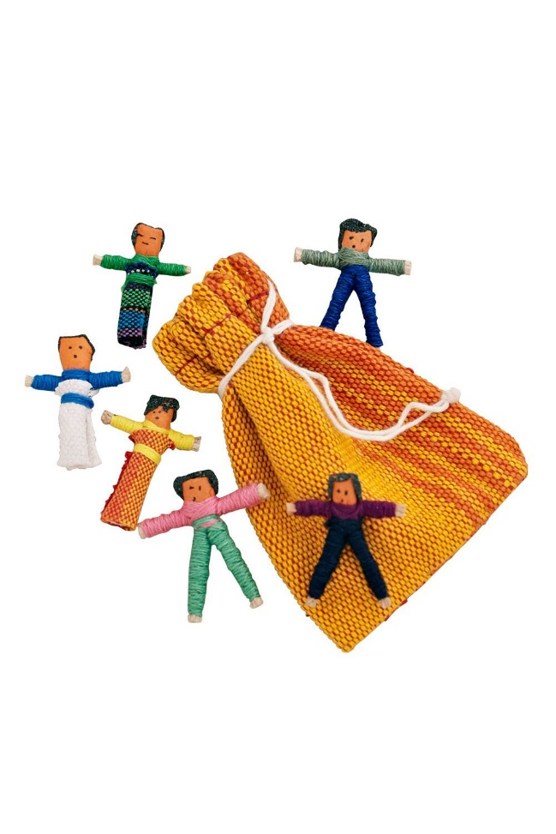
Changes – Worry Dolls
Now make your worry dolls.
Use any materials you can find and the link below to help with some techniques.
https://www.accessart.org.uk/worrydolls/
https://www.youtube.com/watch?v=JJWmReMZSAA

Slide 23
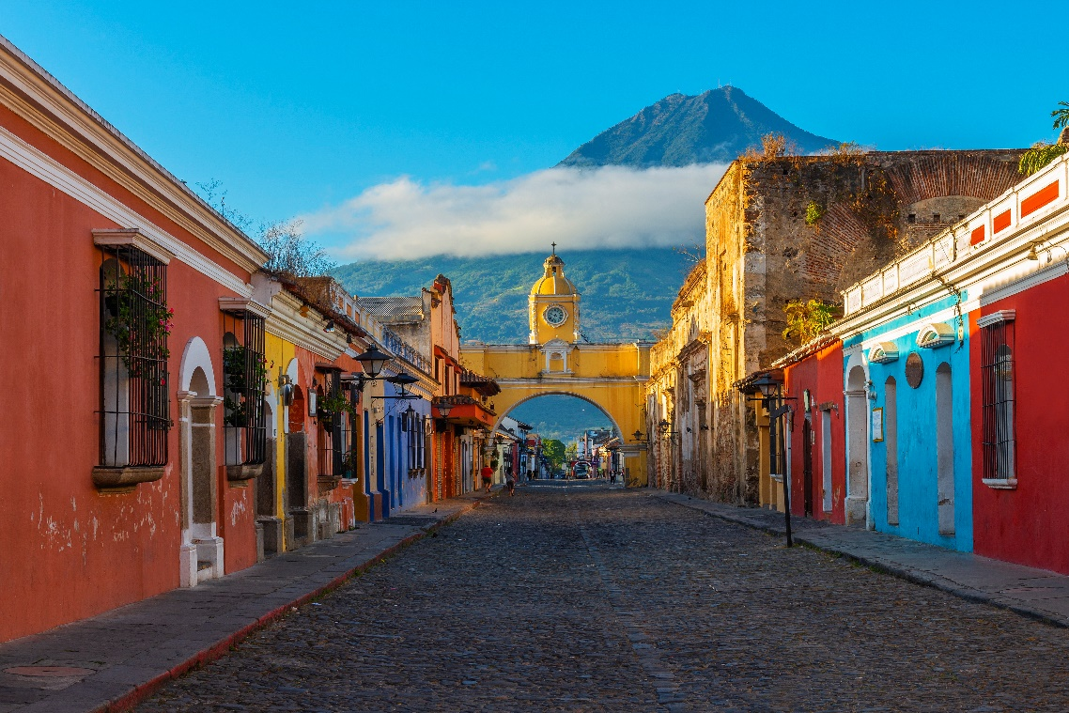
Changes – Worry Dolls
Where is Guatemala?
Research the country of Guatemala and create a fact file or booklet.
You could include:
Where it is?
Climate
Population
Famous sites
Places in Guatemala
What there is to do
Maps
Illustrations
The flag

