Slide 1
Maths – Day 1
Perimeter

Slide 2
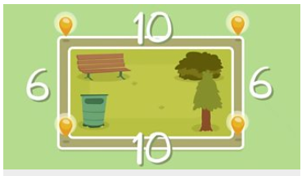
Perimeter
Remind yourself what perimeter is by watching the Bite size clip.
Calculating perimeter
The perimeter is the distance all the way around the outside of a 2D shape.
To work out the perimeter, add up the lengths of all the sides.
https://www.bbc.co.uk/bitesize/topics/zvmxsbk/articles/zsr4k7h

Slide 3
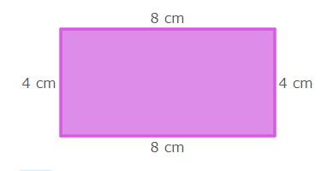
Perimeter
Let’s practice…
Cut out between 5 - 10 equal-sized squares of paper or use square sticky-notes. Put them into one long rectangle.
What is the perimeter of this rectangle?
Rearrange them to make different rectangles - do they all have the same perimeter?
How many different perimeters can you make by rearranging these squares?
https://uk.ixl.com/math/year-5/perimeter

Slide 4
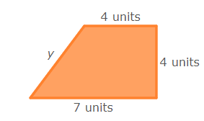
Perimeter
Let’s practice…
Use the Links below to practice finding the perimeter…
Finding the perimeter
https://uk.ixl.com/math/year-5/perimeter
Finding the perimeter with missing sides
https://uk.ixl.com/math/year-5/perimeter-find-the-missing-side-lengths

Slide 5
Perimeter
Your Task…
Can you design your own school playground?
Think of different sections to the playground and what you would like in your playground.
Draw a birds eye view of the playground and measure the different sections.
Add up the perimeter for the different areas.
Challenge: Can you make a playground with the measurements of some sides missing? Give your plan to a friend to work out the perimeters.

Slide 6
8.5 m
Example playground
Not to scale
1.2m
1.8m
1.1m
1.1m
1.6m
21.6m
1.3m
1.4m
5.1m
0.5m
0.4m
2.6m
1.6m
16.2 m
4.1m
5.3m
9.8m
5.3m
3.2m
3m

Slide 7
Maths – Day 2
Area

Slide 8
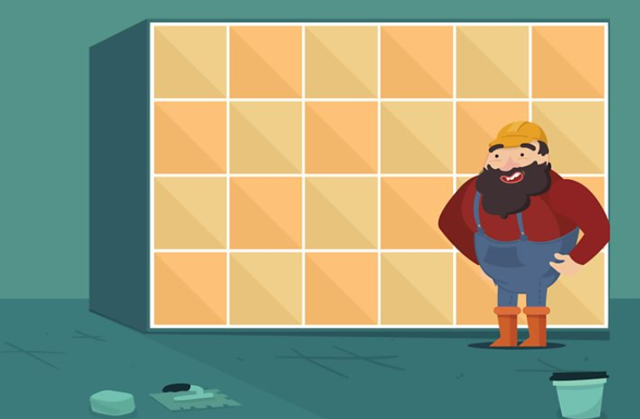
Area
Remind yourself what area is by watching the Bite size clip.
https://www.bbc.co.uk/bitesize/topics/zjbg87h/articles/zwqt6fr
Calculating area
To work out the area of a square or rectangle, multiply its height by its width.
If the height and width are in cm, the area is shown in cm². If the height and width are in m, the area is shown in m².
A square with sides of 5 m has an area of 25 m², because 5 × 5 = 25.
Remember the perimeter is like the crust of a slice of bread and the area is the middle!

Slide 9
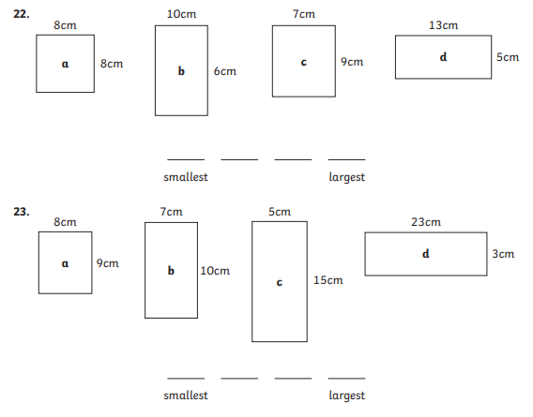
Area
Let’s practice…
Use the calculation to work out the area of the rectangles. Put them in order of smallest area, to largest.

Slide 10
Area
Let’s practice…
Use the square paper print out on the next slide or plain paper to draw 3 different rectangles with an approximate are of 30cm²
Hint –
Think of the factor pair which make 30.

Slide 12
Area
Let’s practice…
Use the Links below to practice finding the Area…
https://uk.ixl.com/math/year-5/select-figures-with-a-given-area
https://uk.ixl.com/math/year-5/find-the-area-between-two-rectangles
https://uk.ixl.com/math/year-5/create-figures-with-a-given-area

Slide 13
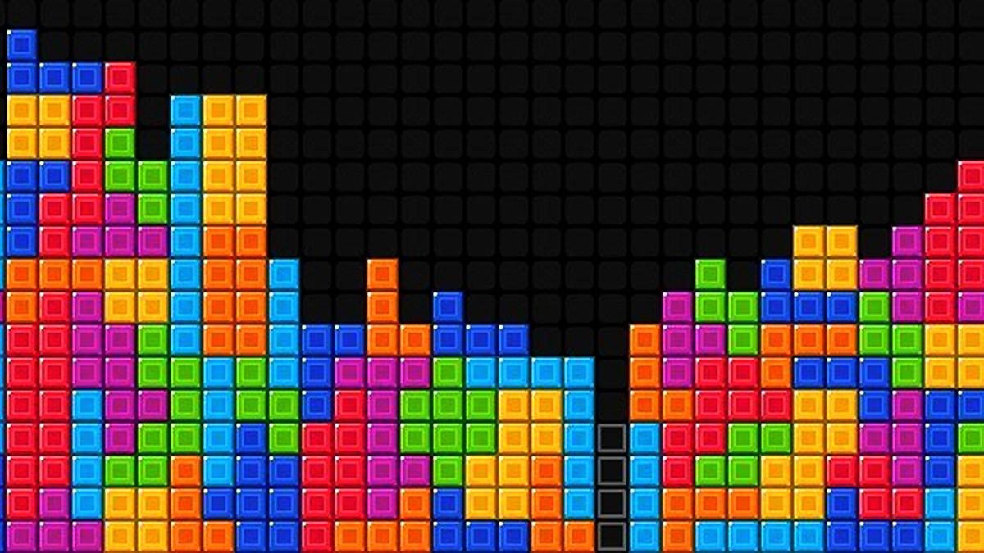
Area
Your task…
Use the square paper print out or a plain piece of paper…
Roll a dice (if you don’t have a dice make number cards 1-9) generate two numbers. These numbers will be your dimensions.
Draw a rectangle with these dimensions and build your shapes up your paper – like tetris.
Work out the area of each shape as you draw them.
What is the area of your completed piece of paper?
Don’t forget are is measured in cm²
Challenge: make compound shapes (shapes made up of more than one shape).

Slide 14
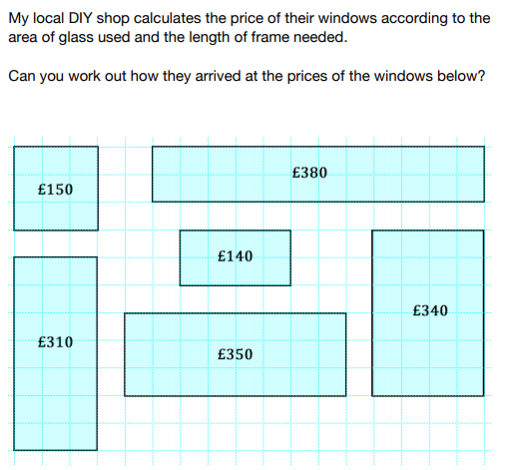
Area
Challenge sheet …
My DIY shop calculates the price of their windows according to the area of glass used and the length of frame needed.
Can you work out how they arrived at the prices of the windows below?

Slide 15
Maths – Day 3
Reading Timetables

Slide 16
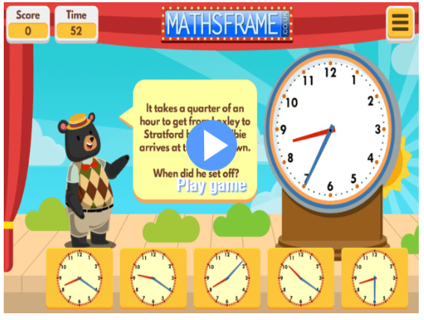
Reading Timetables
Practice time conversion on the Maths Frame games…
https://mathsframe.co.uk/en/resources/resource/119/find-the-start-time
https://mathsframe.co.uk/en/resources/resource/261/using-a-calendar
https://mathsframe.co.uk/en/resources/resource/117/telling-the-time-in-words

Slide 17
Reading Timetables
Lets remind ourselves how they work…
Smithdown Road | 06:30 | 07:10* | 07:30
Sefton Park | 06:47 | - | 07:47
Hope Street | 06:55 | 07.28* | 07:55
Liverpool City Centre | 07:05 | - | 08:05
Albert Dock | 07:11 | 07:38* | 08:11
Reading time tables can be tricky but it’s a very useful skill – especially for you year 6’s who will be getting an exciting new school time table in year 7!

Slide 18
Reading Timetables
Lets remind ourselves how they work…
86 bus timetable
Bus stops on the route
Starting times of the route
a
b
c
Smithdown Road | 06:30 | 07:10* | 07:30
Sefton Park | 06:47 | - | 07:47
Hope Street | 06:55 | 07.28* | 07:55
Liverpool City Centre | 07:05 | - | 08:05
Albert Dock | 07:11 | 07:38* | 08:11
Arrival time at each stop

Slide 19
Reading Timetables
Practice…
Question time…
On route B, what stops does the bus not stop at?
If I wanted to get to Liverpool city centre for 8:15, which bus should I get?
How long is my journey from Smithdown road to the Albert dock?
How much later does bus c arrive at each stop after bus a?
86 bus timetable
a
b
c
Smithdown Road | 06:30 | 07:10* | 07:30
Sefton Park | 06:47 | - | 07:47
Hope Street | 06:55 | 07.28* | 07:55
Liverpool City Centre | 07:05 | - | 08:05
Albert Dock | 07:11 | 07:38* | 08:11

Slide 20
Reading Timetables
Practice – Task A
Question time…
5. I missed bus a at the Hope street stop, how long do I have to wait for a bus?
6. Route d isn’t on the timetable. The bus starts from Smithdown Road at 7:45. What time does it arrive at each stop?
Can you write your own questions?
86 bus timetable
a
b
c
Smithdown Road | 06:30 | 07:10* | 07:30
Sefton Park | 06:47 | - | 07:47
Hope Street | 06:55 | 07.28* | 07:55
Liverpool City Centre | 07:05 | - | 08:05
Albert Dock | 07:11 | 07:38* | 08:11

Slide 21
86 bus timetable
a
On route B, what stops does the bus not stop at?
If I wanted to get to Liverpool city centre for 8:15, which bus should I get?
How long is my journey from Smithdown road to the Albert dock?
How much later does bus c arrive at each stop after bus a?
b
c
d
Smithdown Road | 06:30 | 07:10* | 07:30 | 07:45
Sefton Park | 06:47 | - | 07:47
Hope Street | 06:55 | 07.28* | 07:55
Liverpool City Centre | 07:05 | - | 08:05
Albert Dock | 07:11 | 07:38* | 08:11
5. I missed bus a at the Hope street stop, how long do I have to wait for a bus?
6. Route d isn’t on the timetable. The bus starts from Smithdown Road at 7:45. What time does it arrive at each stop?
7. Can you write your own questions?

Slide 22
Answers…
a
1.On route B, what stops does the bus not stop at?
Sefton Park and Liverpool City centre.
2. If I wanted to get to Liverpool city centre just before 8:15, which bus should I get?
Bus C
3.How long is my journey from Smithdown road to the Albert dock?
41 minutes
4.How much later does bus c arrive at each stop after bus a?
1 hour
b
c
d
Smithdown Road | 06:30 | 07:10* | 07:30 | 07:45
Sefton Park | 06:47 | - | 07:47 | 8:02
Hope Street | 06:55 | 07.28* | 07:55 | 8.10
Liverpool City Centre | 07:05 | - | 08:05 | 8.15
Albert Dock | 07:11 | 07:38* | 08:11 | 8.21
5. I missed bus a at the Hope street stop, how long do I have to wait for a bus?
33 minutes
6. Route d isn’t on the timetable. The bus starts from Smithdown Road at 7:45. What time does it arrive at each stop?

Slide 23
Reading Timetables
The school day
Task B -
Design a weekly school timetable for Year 7. The following criteria has been given to you by the Principal:
The Year 7 class need to have 5 hours of maths, 5 hours of English and 3 hours of science.
Lunch time is one hour and can be anytime between 12:00 and 14:00.
The pupils shouldn’t work for more than two hours without a break.
They should have at least one lesson of Art, P.E., History, French, Geography, Music, R.E. each day.
The school day starts at 08:45 and finishes at 15:30.
The pupils need to answer the register once in the morning and once in the afternoon.

Slide 24
Maths – Day 4
Line graphs

Slide 25
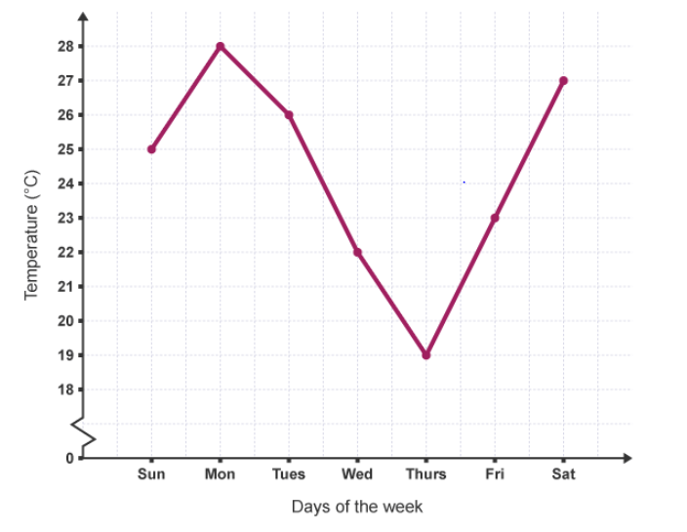
Line Graphs
Remind yourself what a line graph is…
A line graph is often used to show a trend over a number of days or hours. It is plotted as a series of points, which are then joined with straight lines. The ends of the line graph do not have to join to the axes.
This graph shows the temperature over 7 days…
You can tell at a glance that the temperature was at its highest on Monday and that it started to fall in the middle of the week before rising again at the end of the week.

Slide 26
Line Graphs
Remind yourself what a line graph is…
Generate some statements about the data…
E.G.
The highest temperature was…
The lowest was?
From Sunday to Monday the temperature increased/decreased by … degrees.

Slide 27
Line Graphs
Match each Maths Story to the line graph. Explain how you know? What could the graph left represent?
Distance
Distance
Distance
Distance
Time
Time
Time
Time
A car is parked in a car park.
A person walks at a constant speed, stops for a break, then carries on.
A bus travels at a constant speed along the motorway.

Slide 28
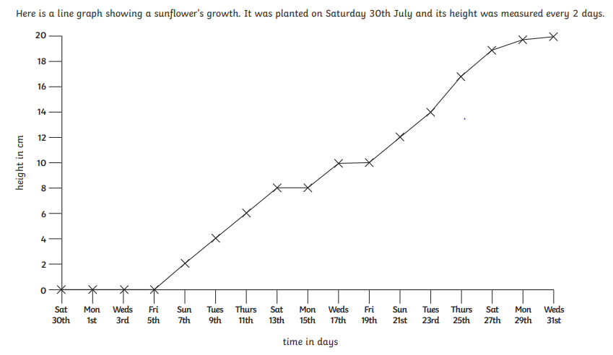
Line Graphs
Your Task…
Use the graph to answer the questions on the next slide.

Slide 29
Line Graphs
Your Task…
How many days did the plant take to grow 18cm?
What is the height difference between Friday 19th and Thursday 25th?
What is the height of the plant on these days:
Thursday 11th
Friday 19th
Monday 29th
4. Why do you think there is no measurement in the first week?
5. Can you generate your own questions using the line graph?

Slide 30
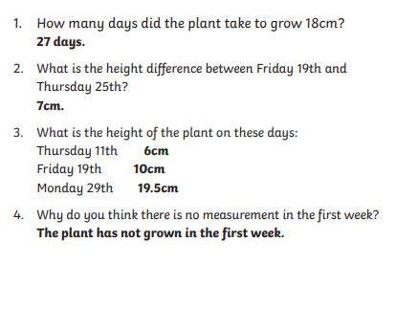
Line Graphs
Answers…

Slide 31
Line Graphs
Challenge Task...
Can you create your own data to represent in a Line graph? Remember, it needs to represent a change over time. E.G how many steps you walk daily over 7 days.
You can draw your graph or use the link to make it online.
https://mathsframe.co.uk/en/resources/resource/111/itp-line-graph

Slide 32
Maths – Day 5
Long Multiplication

Slide 33
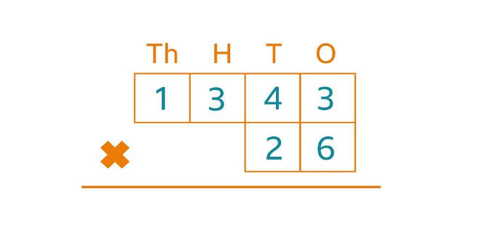
Long Multiplication
Let’s recap…
Parent help
This video from Maths with Parents will help you understand how to do long multiplication. Why not make some notes as you watch the video to help you remember later?
Video…
https://www.bbc.co.uk/bitesize/articles/zjbyvk7
Website help link…
https://www.bbc.co.uk/bitesize/articles/z4chnrd

Slide 34
Long Multiplication
How would we solve 35 x 11?
We need to use long multiplication.
This is how we would set out our calculation:
3 5
We need to draw in 2 sets of equals when multiplying by a 2-digit number.
1 1
X

Slide 35
Long Multiplication
To complete our calculation:
1. Firstly take the 5, and multiply it by the top row.
2. We then need leave a 0 in the ones column for the next row.
3. We then take the 3 and multiply it by the top row.
4. Finally, we add our two answers together and that is our final answer.
3 5
1 1
X
3 5
3 5
0
3 8 5
This is our final answer.

Slide 36
Long Multiplication
Now give these a go…
3 0 4
4 5
6 2
3 2
2 3
2 1
X
X
X

Slide 37
Long Multiplication
How did you do?
3 0 4
4 5
6 2
3 2
2 3
2 1
X
X
X
3
0
4
1
9
0
1
8
6
0
1
1
2
4
0
0
8
1
5
0
6
3
6 3 8 4
1
1
1 4 4 0
1 4 2 6

Slide 38
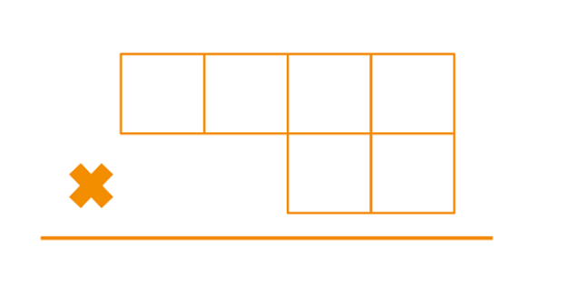
Long Multiplication
Let’s practice…
Use a dice or a set of number cards 0-9 to generate your own 3 or 4 digit number.
Then generate a 2 digit number.
Practice multiplying them together.

Slide 39
Long Multiplication
Now try these, pick the ones you feel most confident with…
Bronze
Silver
Gold
1. 21 x 12
2. 43 x 11
3. 12 x 20
4. 31 x 23
5. 44 x 22
6. 16 x 11
7. 13 x 12
8. 34 x 20
1. 43 x 11
2. 31 x 23
3. 50 x 11
4. 25 x 30
5. 48 x 23
6. 52 x 35
7. 63 x 39
8. 89 x 13
1. 52 x 35
2. 63 x 39
3. 89 x 13
4. 102 x 27
5. 275 x 35
6. 462 x 14
7. 138 x 12
8. 950 x 25

Slide 40
Long Multiplication
Extra sheets …
https://bam.files.bbci.co.uk/bam/live/content/zmbbgwx/pdf#sa-link_location=blocks&intlink_from_url=https%3A%2F%2Fwww.bbc.co.uk%2Fbitesize%2Farticles%2Fzjbyvk7&intlink_ts=1593591167463-sa
One digit multiplication…
https://bam.files.bbci.co.uk/bam/live/content/zkhhpg8/pdf#sa-link_location=blocks&intlink_from_url=https%3A%2F%2Fwww.bbc.co.uk%2Fbitesize%2Farticles%2Fzjbyvk7&intlink_ts=1593591482930-sa

Slide 41
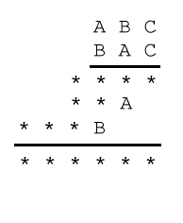
Long Multiplication
Can you give this challenge a go?
This task is a real challenge! You may like to try trebling and all the digits first.
In the multiplication below, some of the digits have been replaced by letters and others by asterisks. Where a digit has been replaced by a letter, the same letter is used each time, and different letters have replaced different digits. Can you reconstruct the original multiplication?

